Slide 1
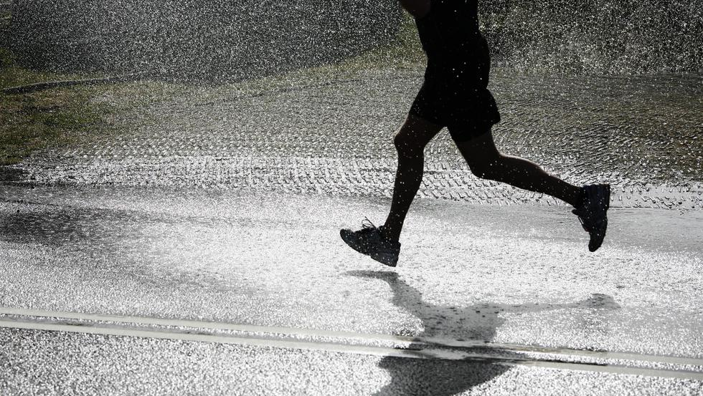







SU
MO
TU
WE
TH
FR
SA
16 | 24
6,780,678
GOALS COMPLETED
KCAL
36
96 bpm
118 mgdl
85 %
O
TEMPERATURE
HEART RATE
BLOOD GLUCOSE
BODY HYDRATION
HEART RATE
36%
Mg
56%
Zn
Ph
73%
Ca

Slide 2
SU
MO
TU
WE
TH
FR
SA
16 | 24
6,780,678
GOALS COMPLETED
KCAL
36
96 bpm
118 mgdl
85 %
O
TEMPERATURE
HEART RATE
BLOOD GLUCOSE
BODY HYDRATION
HEART RATE
36%
Mg
56%
Zn
Ph
73%
Ca

Slide 3
SU
MO
TU
WE
TH
FR
SA
16 | 24
6,780,678
GOALS COMPLETED
KCAL
36
96 bpm
118 mgdl
85 %
O
TEMPERATURE
HEART RATE
BLOOD GLUCOSE
BODY HYDRATION
HEART RATE
36%
Mg
56%
Zn
Ph
73%
Ca

Slide 4
SU
MO
TU
WE
TH
FR
SA
16 | 24
6,780,678
GOALS COMPLETED
KCAL
36
96 bpm
118 mgdl
85 %
O
TEMPERATURE
HEART RATE
BLOOD GLUCOSE
BODY HYDRATION
HEART RATE
36%
Mg
56%
Zn
Ph
73%
Ca

